Slide 1
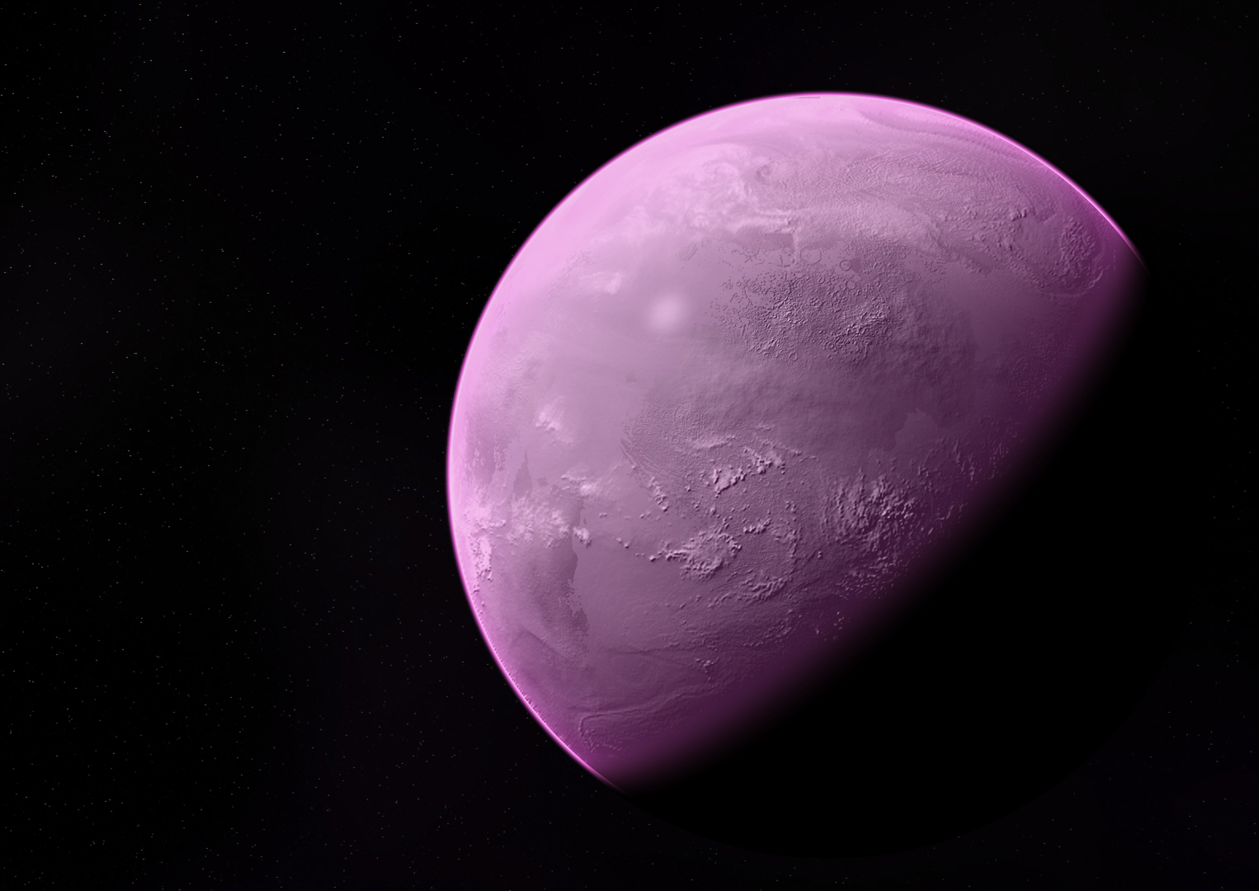
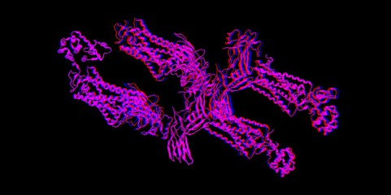
Ancient Pigments:
A Colorful History
Cathryn Sephus
Department of Molecular and Cellular Biology
Kacar Lab
April 13, 2019

Slide 2
Biosignatures: What color is life?
What are biosignatures?
Colors as Surface Biosignatures
Spacer. Wallhere. 2017
Notes:
Define what rhodopsins and other biological terms are

Slide 3
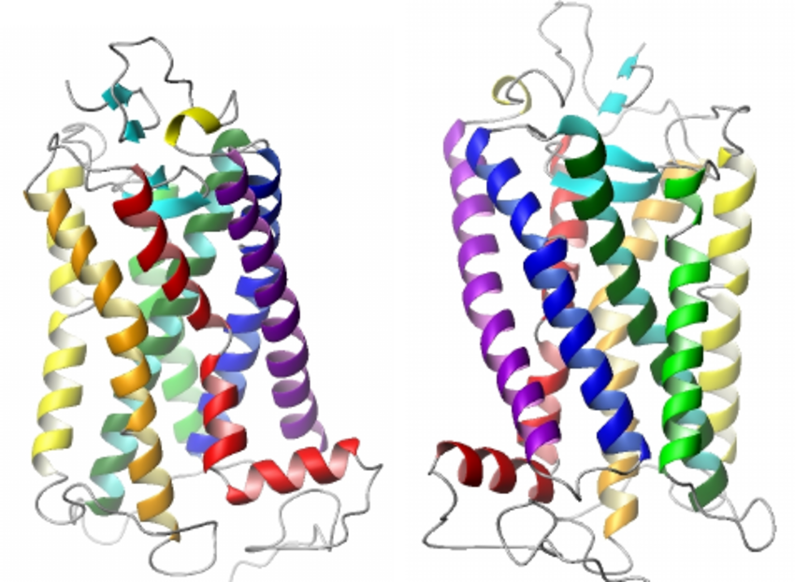
Rhodopsins: Ancient Pigment Proteins
Rhodopsins present in earliest life
Wide range of color emissions
Can be used as potential biosignature
Wichard, Jorg. IEEE. 2008
Notes:
Earth has stable conditions for life - 4.0 Ga : Type 1 Rhodopsins present in Eukaryotes (algae, fungi) - 3.2 Ga: Type 1 Rhodopsins present in Prokaryotes- 3,8 Ga : Type 2 Rhodopsins present in Metazoans - 2.0 Ga

Slide 4
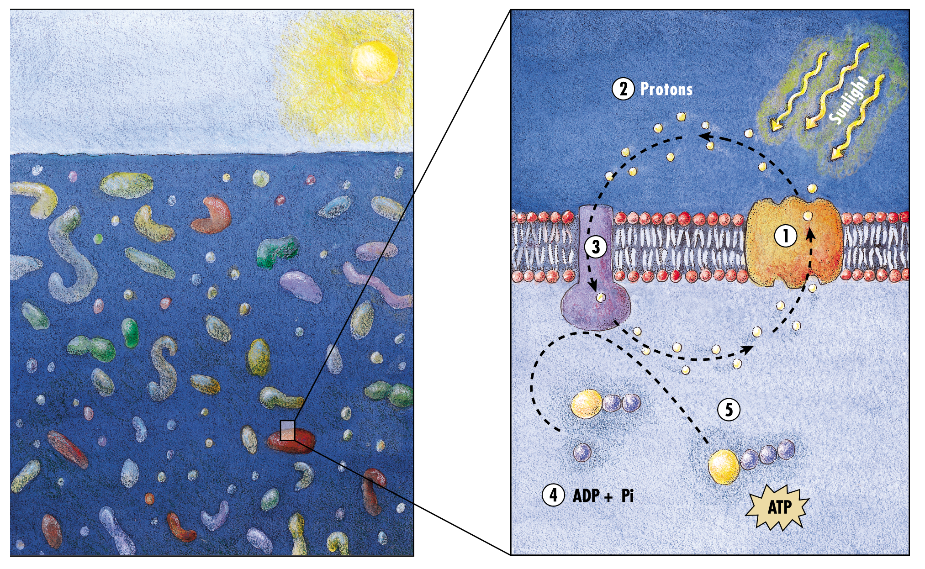
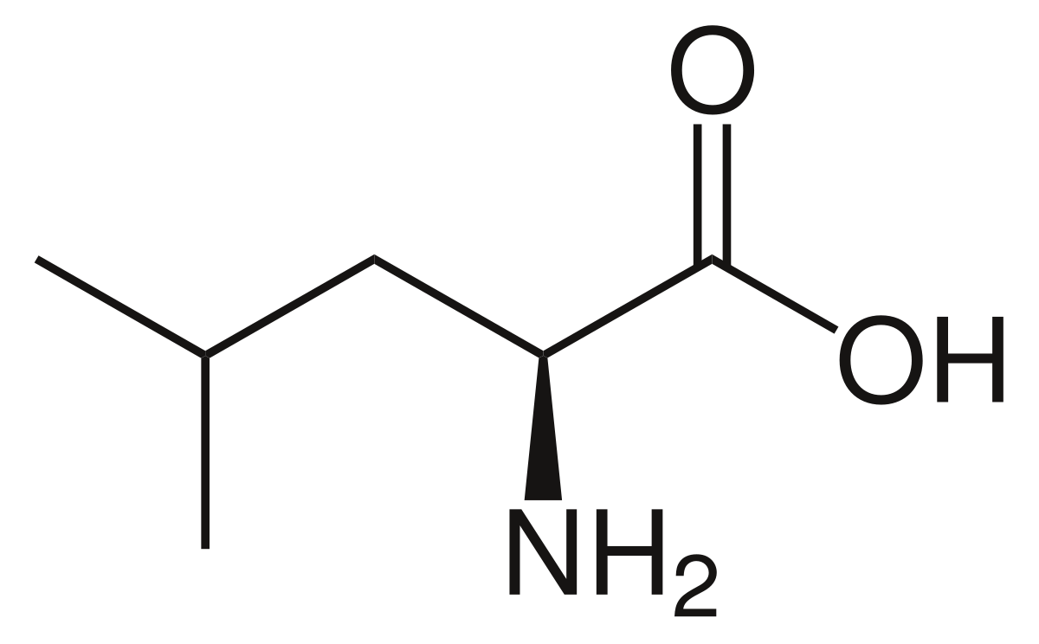
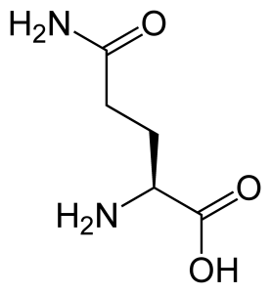
Proteorhodopsin: Spectrally Tuned for Maximum Absorption
Proteorhodopsin is a direct way to investigate the evolutionary history...
Leucine
… of color change.
Glutamine
DeLong, Edward. PLoS Biology. 2010.
Notes:
Justify why I care about proteorhodopsin: most numerous, two colors: pigment colors change and evolve- spectral colors changing overtime

Slide 5
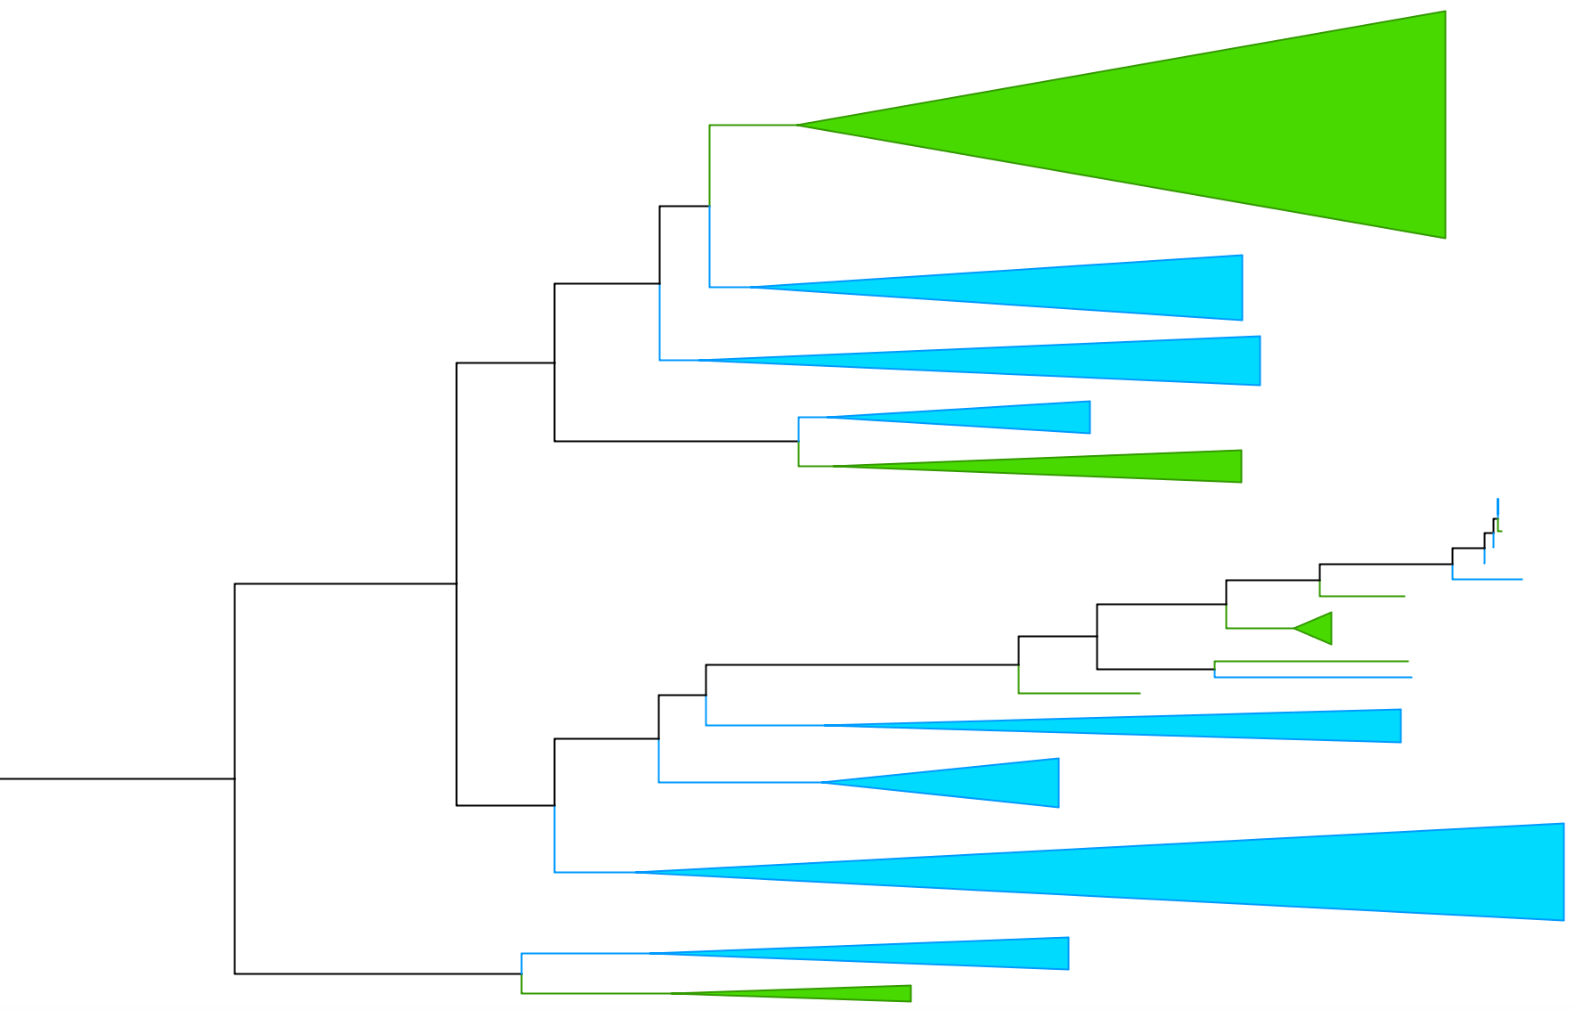
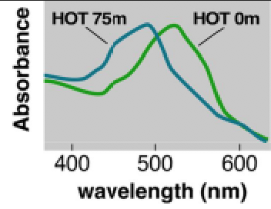
Proteorhodopsin subgroup relationships
Evolutionary Tree of Proteorhodopsins
Color Time?
Pinhassi, Jarone. Microbiology and Molecular Biology Reviews. 2016.
Blue-light absorbing proteorhodopsin
Green-light absorbing proteorhodopsin
Notes:
Blow up the alignment and focus in on the 105 area
Move the sequences and try to line L/Q up with the tree
Presence of residues haven’t been experimentally determined...

Slide 6
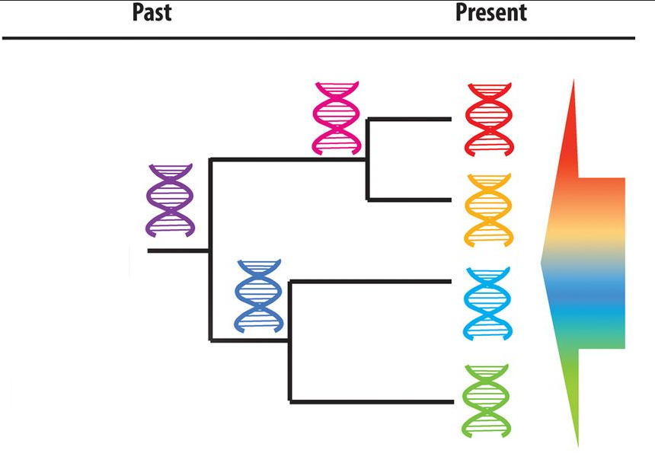
Traveling Through Time: Retracing Ancient History
Ancestral Sequence Reconstruction (ASR)
Enables identification of ancient protein sequences based on modern versions
Offers a peek into the evolution of protein complexes
Gumulya, Yosephine. Biochemical Journal. 2016

Slide 7
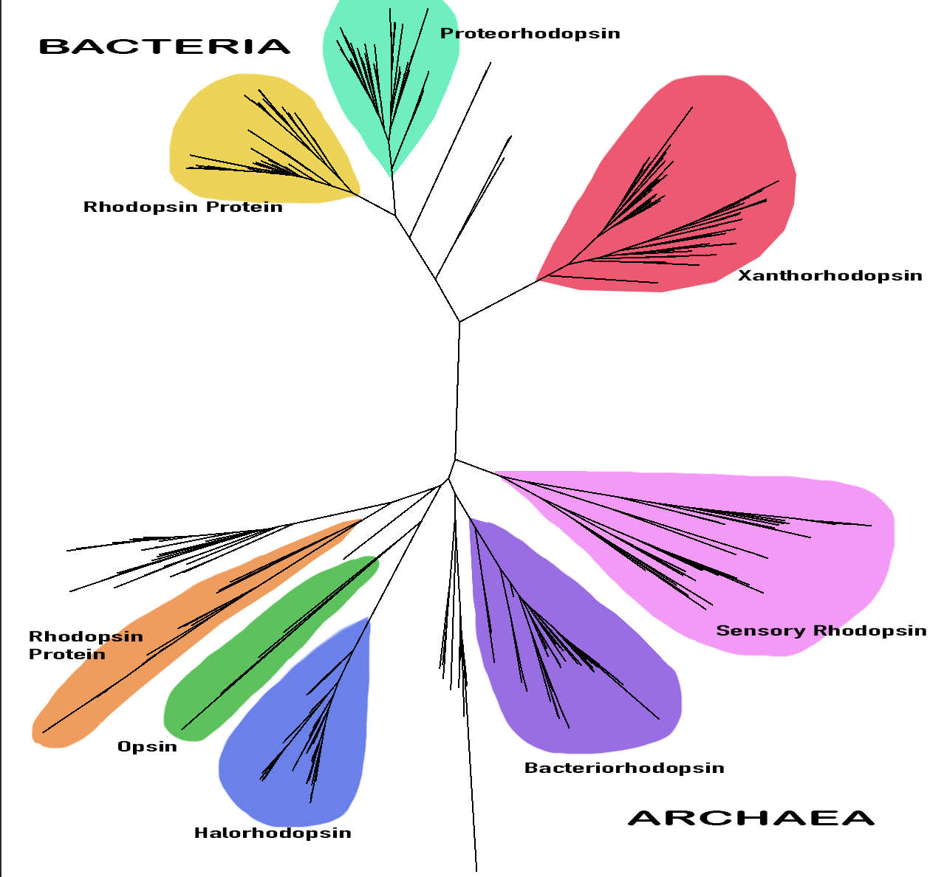
A “Color-full” History
Archaea + Bacteria both contain rhodopsin
Diversification of color & expansion of biosignatures
Notes:
Bigger picture- what do the findings mean?
How does this apply to earth ecology- omnipresence of proteorhodopsin, earth history and such
Diverse phyla
Discuss the evolutionary history between all rhodopsins
Color diversification → color in rhodopsin proein pigments evolved in early earth

Slide 8
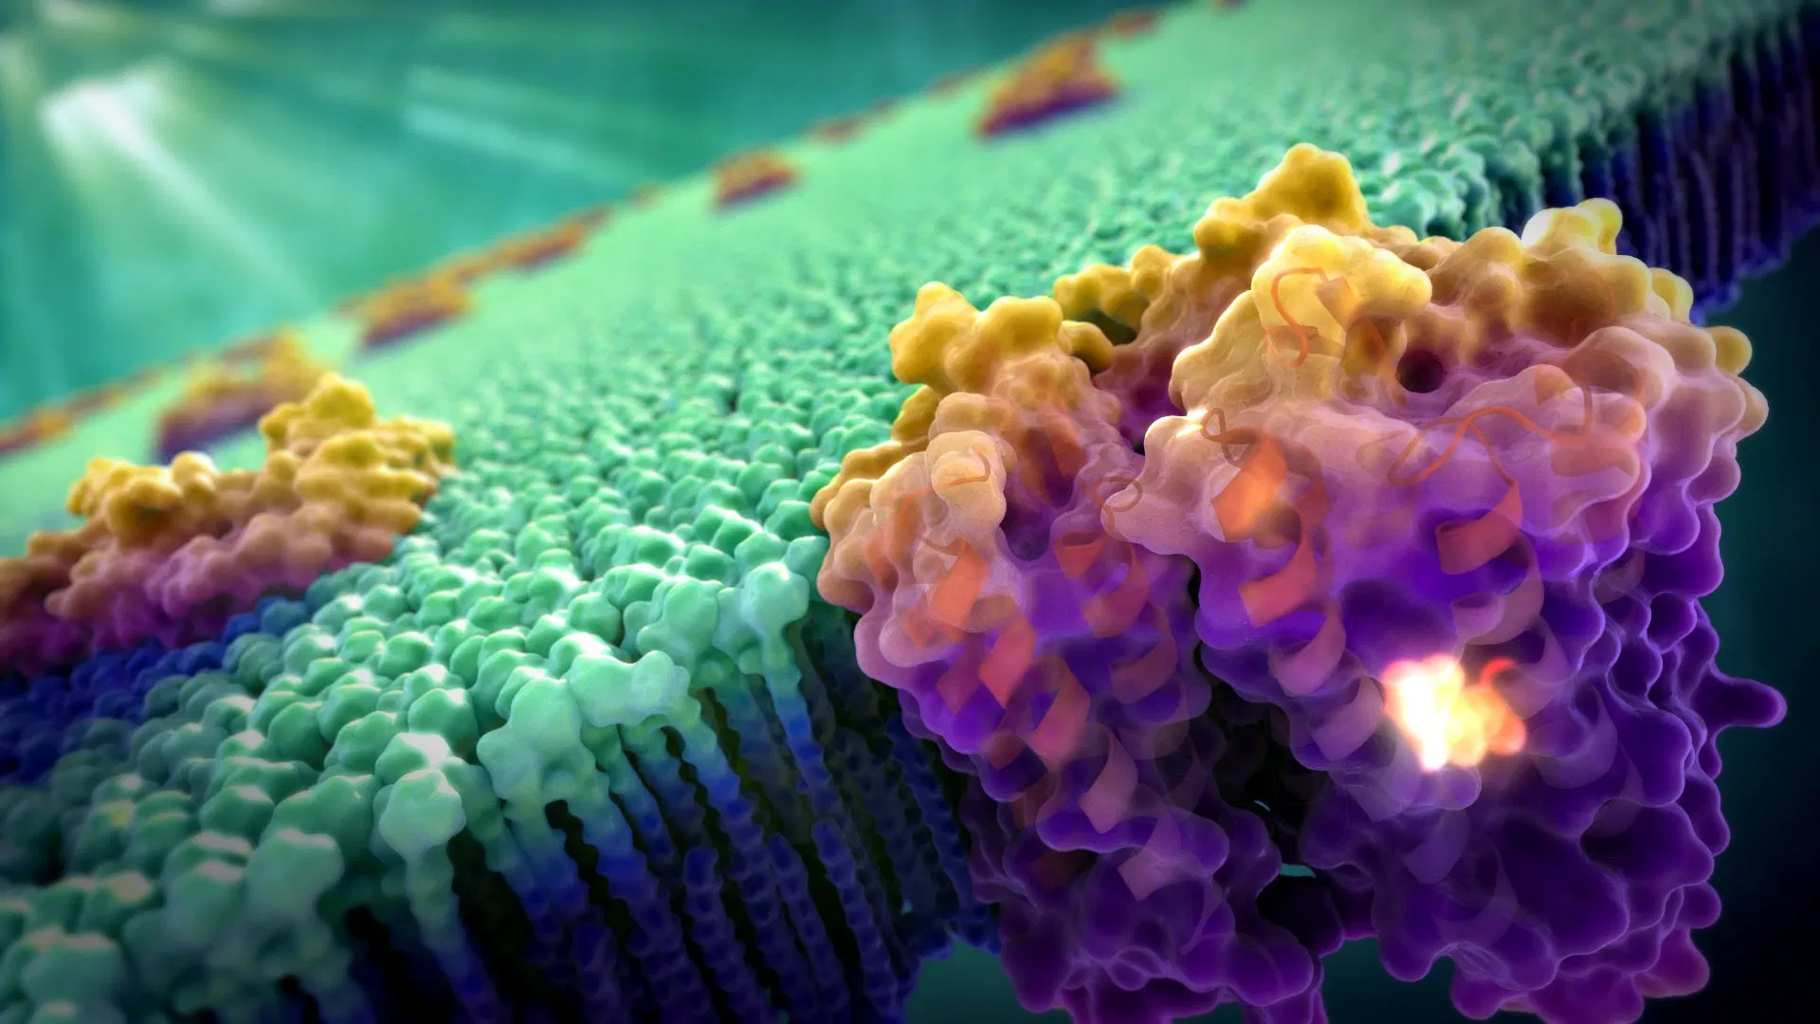
What Comes Next?
Moving Forward With Proteorhodopsin
Answering the questions:
It is it more or less advantageous to absorb blue or green light?
Which group came first: Blue or Green?
Guens, Gelena. Art of the Cell. 2014
Notes:
Brief summary of the main findings/ a summary of the results
Ideas for future work

Slide 9
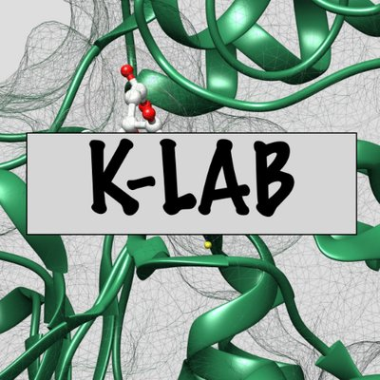
Thank You!
Arizona Space Grant
University of Arizona
NASA
Betul Kacar
Amanda Garcia
Michelle Coe
Kacar Lab
Templeton Foundation
National Science Foundation
Notes:
Must be in powerpoint form

Slide 10
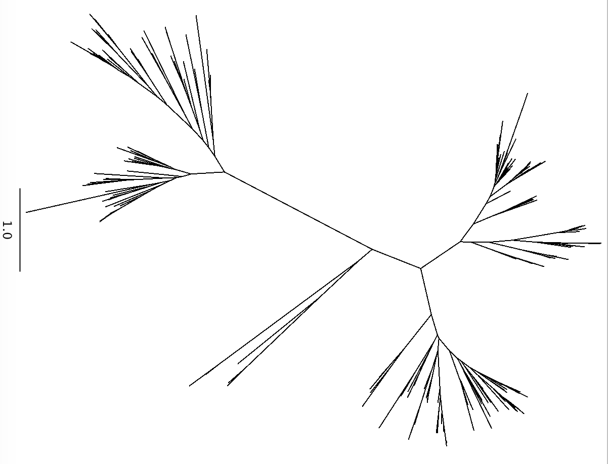
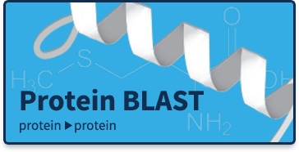
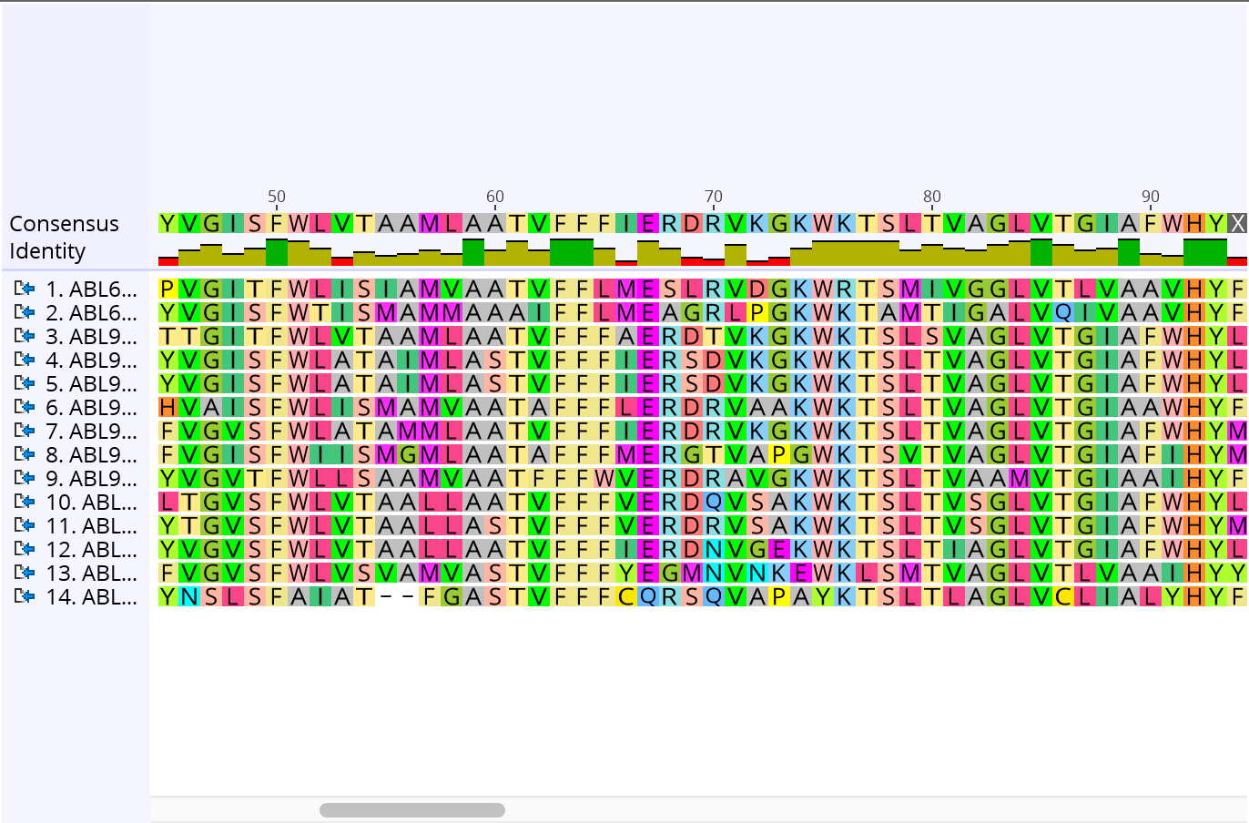
Protein Sequence Reconstruction
BLASTp
Protein Multiple Sequence
Alignment
Maximum Likelihood Tree
Notes:
Explain the biology terminology (planetary science, geology, astronomy...)

